Slide 1
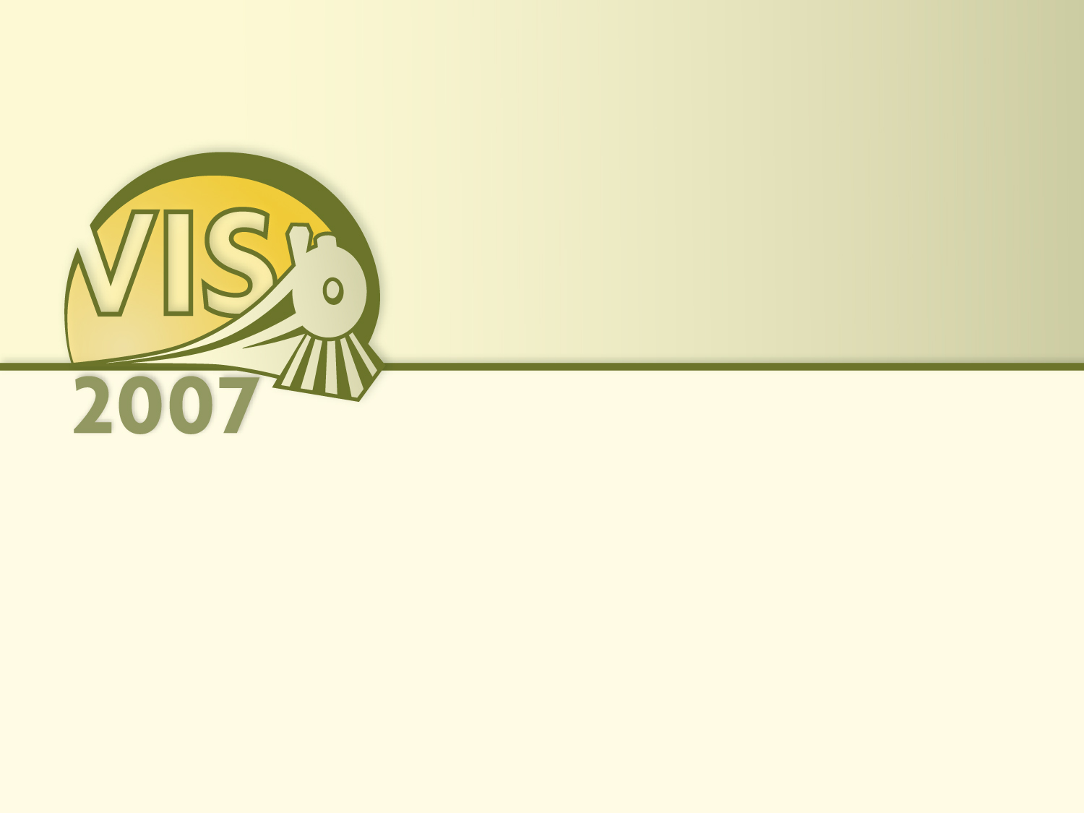
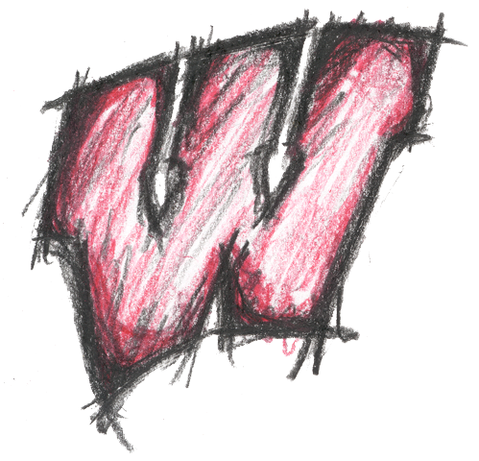
Molecular Surface Abstraction
Gregory Cipriano and Michael Gleicher
University of Wisconsin-Madison
Notes:
Hello. My name is Greg Cipriano, and today I will present work done in collaboration with my advisor Michael Gleicher at the University of Wisconsin-Madison called Molecular Surface Abstraction.

Slide 2
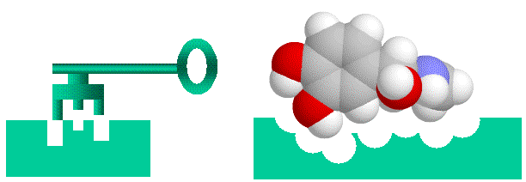
Structural Biology: form influences function
Standard metaphor: Lock and key
Proteins and their ligands have complementary
Shape
Charge
Hydrophobicity
...
Notes:
Structural biology is the study of how the form of individual macro-molecules influences their biological function. When looking at the functional surface of a protein, for instance, a common metaphor is one of a lock and key. Binding partners, called ligands, share complementary features of this surface, like shape, charge, and hydrophobicity.
By analyzing these properties, structural biologists can discover interesting things about how a protein functions, what binding partners it may have, and exactly how specific that protein is to each of its partners.

Slide 3
The functional surface
Solvent excluded interface
Charge fields
Binding partners
Porin Protein (2POR)
Notes:
Depicted here is a traditional way of looking at the surface of a protein. You'll note a number of the features I mentioned are drawn. The geometry itself denotes the region where water can't get in, and represents this protein's "interface".
The underlying charge field generated by its atoms are sampled onto this surface, with blue denoting a positive charge, red negative and white neutral. And the yellow atoms show known binding partners.

Slide 4
How scientists currently look at molecular surfaces
Hard to get the big picture…
The surface is just too complex.
See the hole?
Porin Protein (2POR)
Notes:
Unfortunately, when conveyed in this way, especially in the static shot here, it’s hard to comprehend all of these things. The surface is too complex, with high frequency detail both in its underlying geometry, as well as in the surface charge field. Further, it’s hard to tell which portions of surface interact with the ligands.
If you have especially good eyes, you might notice that there’s a hole going through this protein. But I couldn’t. And I bet you can’t either.

Slide 5
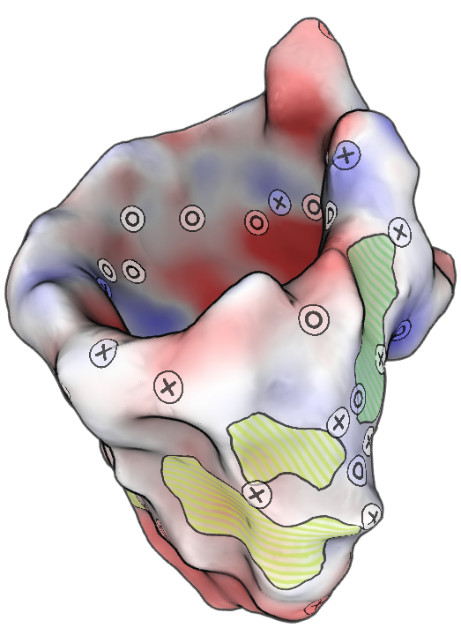
Our surface abstraction
Guiding principle:
Convey the big picture, without getting mired in detail…
Porin Protein (2POR)
Notes:
So we introduce "Abstracted Molecular Surfaces" as a tool to help overcome these issues. These abstractions convey the big picture, removing details that might otherwise get in the way.

Slide 6
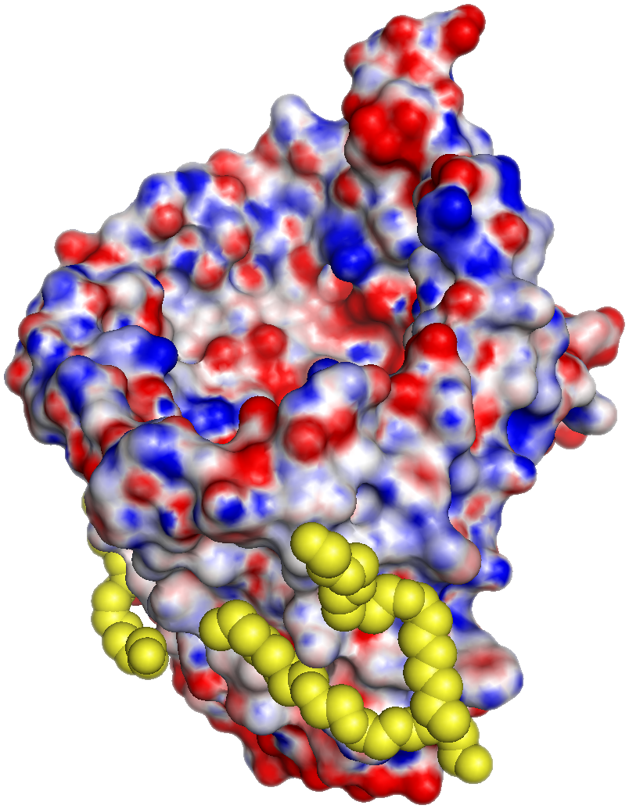
Our surface abstraction
Hole through protein
is now visible
Ligands were here
Notes:
So you can now clearly see the hole, which is important, since this protein acts to shuttle molecules across a membrane, and that’s where they go.
We’ve also highlighted regions in yellow where each ligand binds to the surface of the protein. So we can actually remove them entirely and still get a picture of what areas of the surface have known, meaningful interaction with the outside world.

Slide 7
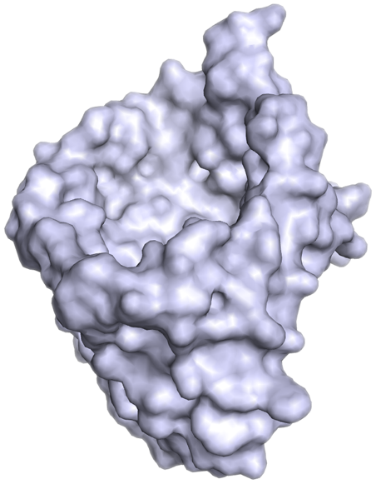
Our source data: The geometric surface
A (naked) geometric surface
Notes:
Before I go to far into describing our method, let me tell you what we leave to others. We take as input into system a geometric surface, which is constructed from underlying data using off-the-shelf software.

Slide 8
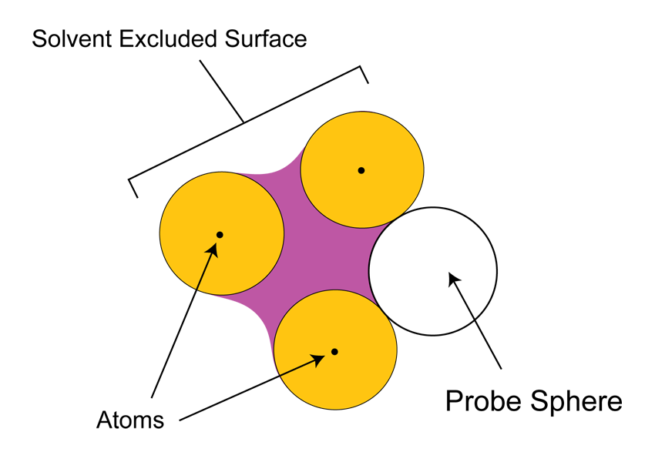
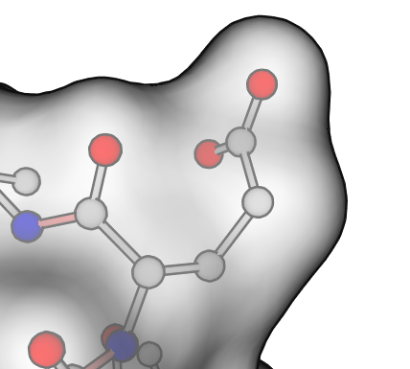
Our source data: The geometric surface
Notes:
This surface can be thought of as the result of rolling a water-sized ball, called the probe-sphere, over a bunch of atoms and building a triangular mesh over the areas it contacts.
Here you can see a region in purple which is not part of any atom, but which is still inaccessible to water, and so is considered part of the molecule's interior.
On the right is a detail of the same thing, showing part of a molecule and its corresponding surface.

Slide 9
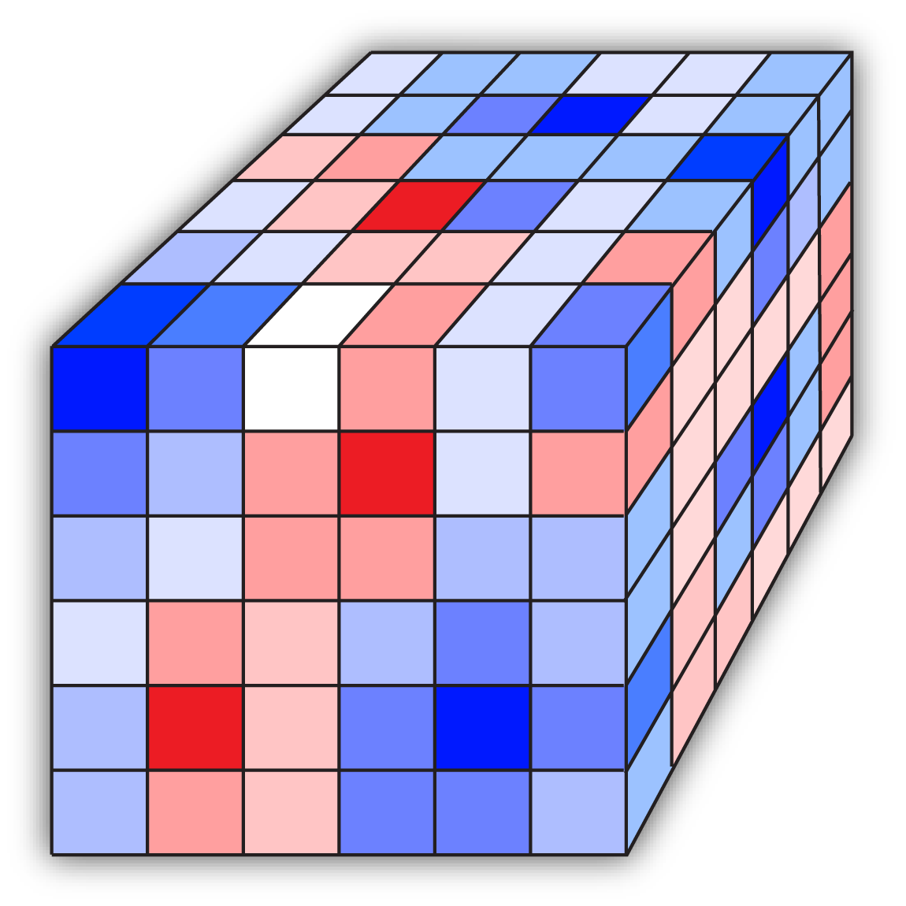
Our source data: The charge field
Notes:
We also don’t perform any charge computations ourselves, but instead read in volumetric charge data from another source. This comes in a form kind of like this cube, with each voxel representing the scalar charge in that region. And again we’ve colored things so that red represents negative values, blue positive, and the degree of saturation represents the magnitude of that charge.

Slide 10
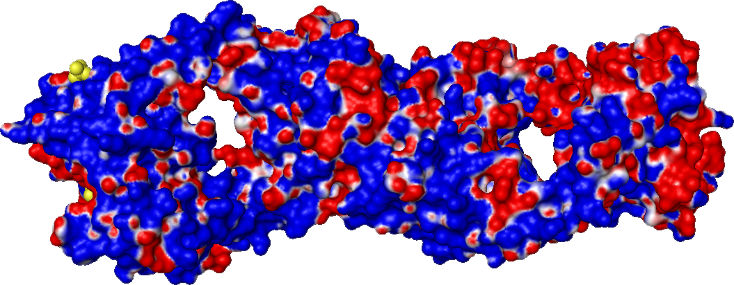
Another confusing surface
Catalytic Antibody (1F3D)‏
Rendered with PyMol
Notes:
Here's another example of a molecular surface, and again, notice how even though this isn’t even a very big molecule, by biological standards, it’s complex enough to make both its basic shape and charge structure hard to understand.

Slide 11
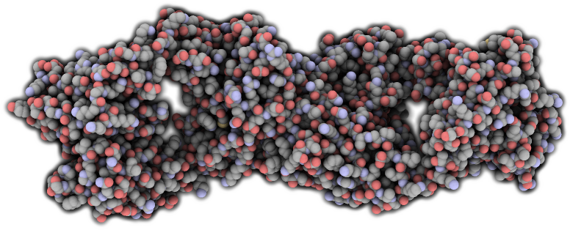
Prior art: QuteMol
Stylized shading helps convey shape
Notes:
QuteMol embraces this complexity, and in doing so uses stylized shading and contouring to mitigate its effects and convey the overall shape. But it’s still a lot to take in.

Slide 12
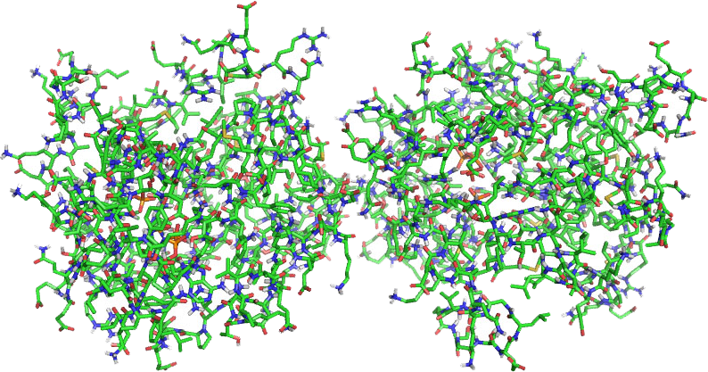
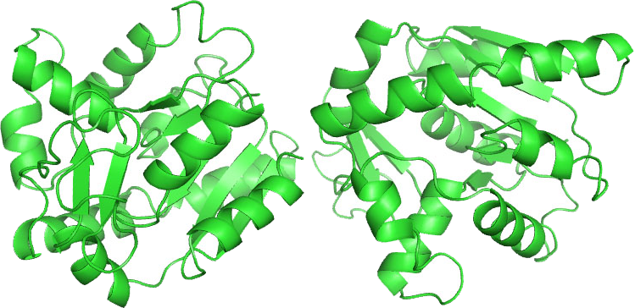
How do molecular biologists deal with visual complexity?
Confusing stick-and-ball
model
Abstracted ribbon representation.
Notes:
Biologists run into the same problem when looking at stick-and-ball representations, but they've come up with clever abstractions
(TRANSITION)
such as this ribbon representation, to help them reduce clutter, and better understand what's going on. It should be noted that the ribbon representation is not intended to replace the stick-and-ball model, but instead serves as an additional, complementary view.

Slide 13
How do they do the same thing with surfaces?
... they don't.
Notes:
Back to the previous surface. How do they currently perform abstractions?
(TRANSITION)
Well, they really don't.

Slide 14
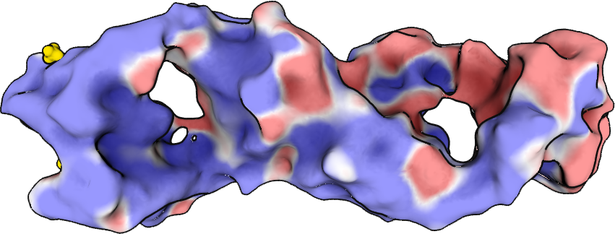
Our method: abstraction
Abstracts both geometry and surface fields (e.g. charge).
Notes:
We intend to change this by abstracting both the geometry, as well as other surface fields, like charge, into this sort of representation.
We borrow from QuteMol and others the idea of using stylized rendering techniques to emphasize contours and enhance depth-cuing. Here, we’ve applied ambient occlusion lighting to contrast the interior and exterior regions, contour lines to highlight depth discontinuities and silhouette shading to further emphasize foreshortening.

Slide 15
But wait! There’s more...
We show additional information using decals.
Why? We have more to show, and we’re already using color.
Notes:
But wait, there’s more. Functional surfaces contain a lot more information than just geometry and charge. And we’re already using color for the latter. So we apply decals to the surface to allow us to render additional information without confusion.
Further, by using decals, we can notate interesting regions using symbols, which can be more intuitive than color anyway.

Slide 16
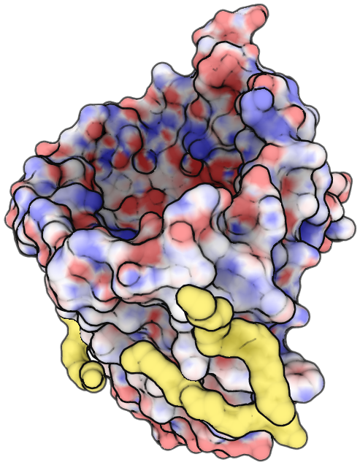
How we can use decals
Predicted Ligand
Binding Sites
Notes:
In our system, we use these decals to depict possible ligand binding sites, represented here by a green textured region, that were found by a surface analysis tool...

Slide 17
How we can use decals
Ligand
Shadows
Notes:
And what we call ligand shadows, which, as I mentioned before, denote regions of the surface which are in close proximity to known binding partners.

Slide 18
Abstraction in 4 steps
Our method:
1. Diffuse surface fields
2. Smooth mesh
3. Identify and remove remaining high-curvature regions
4. Build surface patches and apply a decal for each patch
Notes:
Now I'll go over the four parts of our algorithm in detail.
First, I'll talk about how we diffuse surface fields over our surface.
Next, I'll talk about how we smooth the surface, then how we identify and resmooth regions that were not left smooth enough in the first pass.
Finally, I'll discuss our method for building and applying surface patches onto our surface.

Slide 19
Abstraction in 4 steps
Our method:
1. Diffuse surface fields
2. Smooth mesh
3. Identify and remove remaining high-curvature regions
4. Build surface patches and apply a decal for each patch

Slide 20
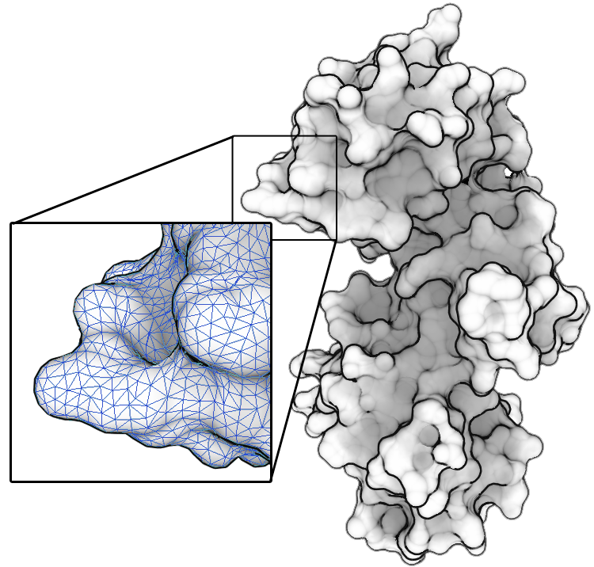
Diffusing surface fields
Starting with a triangulated surface:
Notes:
So as I mentioned, we begin with a triangulated surface.

Slide 21
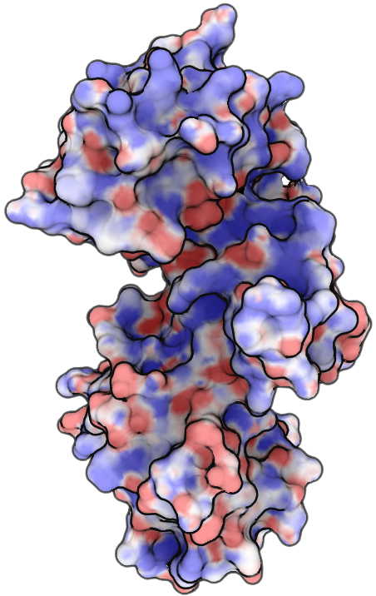
Diffusing surface fields
Starting with a triangulated surface:
We sample scalar fields
onto each vertex:
Notes:
We sample scalar fields, such as charge, onto each vertex.
Now what we'd like to do is reduce the mottled appearance of multiple conflicting charges (as you can see near the bottom of this molecule), while preserving large regions of uniform value.

Slide 22
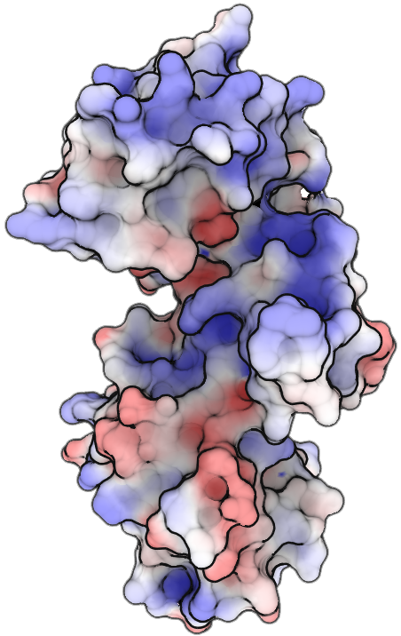
Diffusing surface fields
Starting with a triangulated surface:
We sample scalar fields
onto each vertex:
And smooth them, preserving
large regions of uniform value.
Notes:
Like this. Notice that the blue region at the top has become more prominent, which is good since this protein binds to RNA, which is mostly negative, and it’s been hypothesized by some of our collaborators that the way it does that is by winding itself around the crevice.

Slide 23
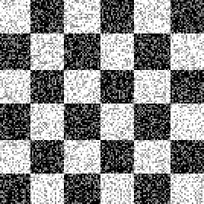
Smoothing
Standard Gaussian smoothing tends to destroy region boundaries:
Weights pixel neighbors by distance when averaging.
Notes:
To get there, we could use a standard blurring technique, like the gaussian filter we apply here. But this would tend to smear the values out, which is counter to our goal of preserving distinct regions.

Slide 24
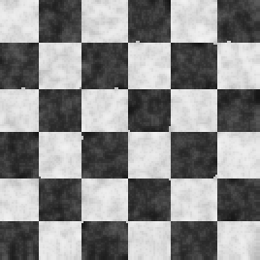
Bilateral filtering
A bilateral filter* smooths an image by taking into account both distance and value difference when averaging neighboring pixels.
* C. Tomasi and R.Manduchi. Bilateral filtering for gray and color images. In ICCV, pages 839–846, 1998.
Notes:
Instead, we use a variation on a bilateral filter, which smooths an image by taking into account both distance and value difference when averaging neighboring pixels. Here, it's applied to the noisy image on the left…

Slide 25
Bilateral filtering
A bilateral filter* smooths an image by taking into account both distance and value difference when averaging neighboring pixels.
...producing a smooth result
while still retaining sharp edges.
Notes:
…producing smooth regions with sharp, well-defined boundaries in the image on the right.

Slide 26
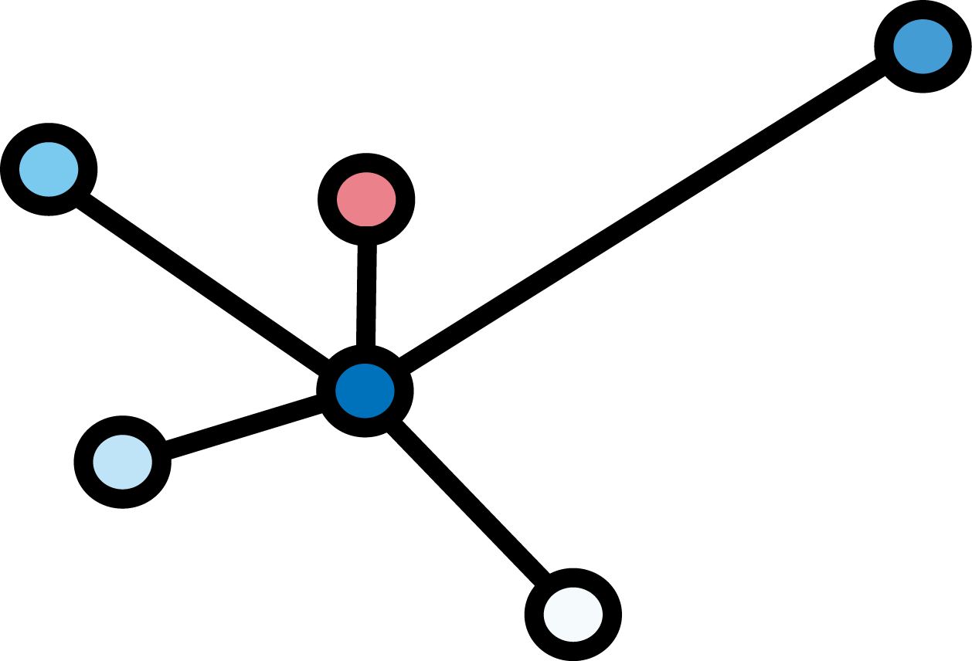
Bilateral filtering
We do the same thing, but on a mesh:
A vertex and its
immediate neighbors
Notes:
Now, we operate on a mesh, which can be thought of as an graph. But the same principles apply.
A slight difference is that the standard bilateral filter operates on all pairs of pixels in an image. We could have done the same thing on the mesh, but we found that in practice by instead averaging only the immediate neighbors, and iterating until convergence, we could produce a similar result faster.

Slide 27
Abstraction in 4 steps
Our method:
1. Diffuse surface fields
2. Smooth mesh
3. Identify and remove remaining high-curvature regions
4. Build surface patches and apply a decal for each patch
Notes:
Next, we smooth the geometry of the mesh to remove small details.

Slide 28
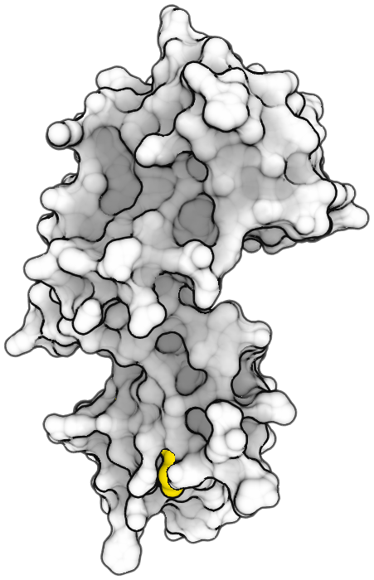
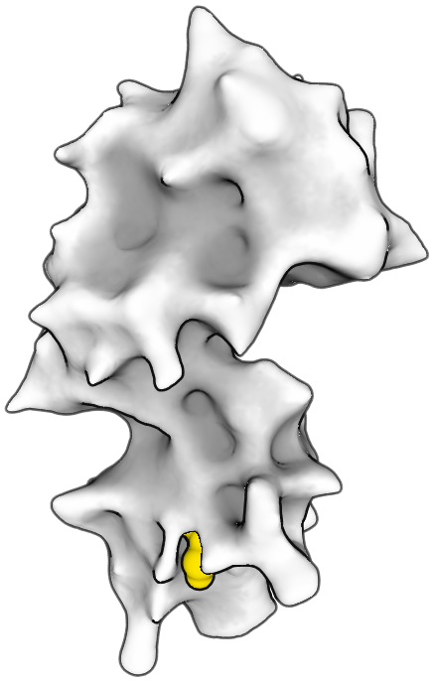
Smoothing the mesh
Taubin* (lambda/mu) smoothing
Pros:
Fast
Volume preserving
Easy to implement
* G. Taubin. A signal processing approach to fair surface design. In Proceedings of SIGGRAPH 95, pages 351–358.
Notes:
Taubin smoothing is a fast, well known method for smoothing meshes that operates in two passes.
The first pass replaces each vertex with a weighted average of the positions of its nearby points, which tends to contract the mesh.
The second pass counteracts this contraction. So Taubin is volume preserving, and since it operates locally, it's also fast.
But unfortunately, its results are not smooth enough.

Slide 29
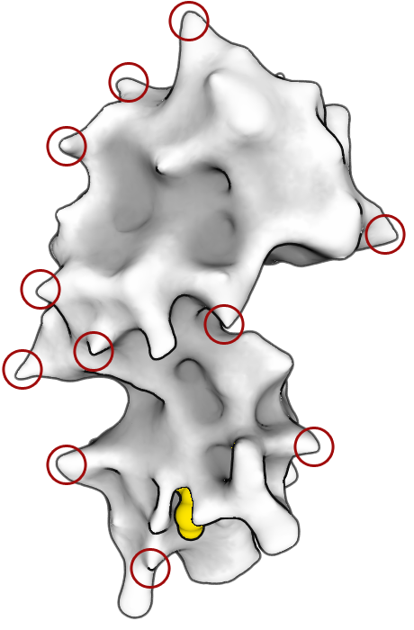
The trouble with smoothing...
Taubin (lambda/mu) smoothing
Cons:
Contractions produce artifacts
Resulting mesh still has regions of high curvature...
Notes:
Here, the good news is that our Taubin filter smooths out small features. The bad news is that because of how it contracts the surface, mid-sized features remain that still exhibit objectionable curvature (are pointy). And that will get in the way when we later want to apply decals.

Slide 30
Abstraction in 4 steps
Our method:
1. Diffuse surface fields
2. Smooth mesh
3. Identify and remove remaining high-curvature regions
4. Build surface patches and apply a decal for each patch
Notes:
So we perform an extra pass to address these specifically.

Slide 31
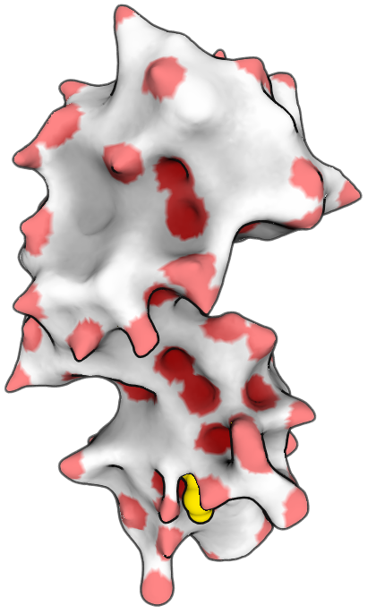
Further abstraction: “sanding”
Select a user-defined percentage
of vertices with highest curvature.
Grow region about each point.
Remove, by edge-contraction, all
but a few vertices in each region,
proceeding from center outward.
Notes:
Here, we've highlighted a percentage of the vertices of highest curvature
(TRANSITION).
We expand each point to a circular region
(TRANSITION)
and then remove all but a few of the vertices from within that region by edge collapse, taking care to
avoid triangle flips.

Slide 32
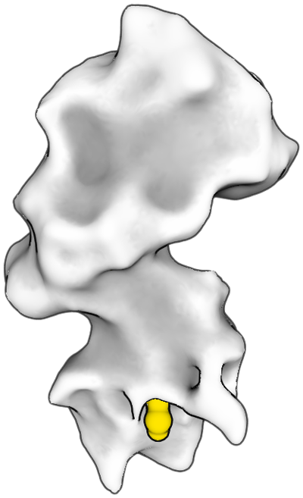
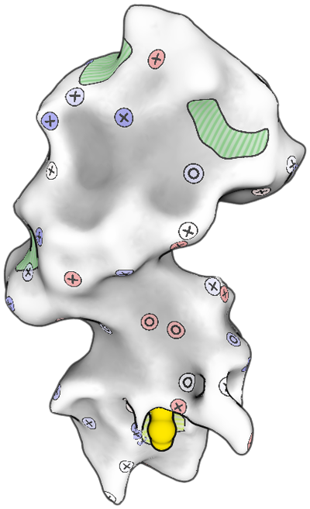
Final smooth mesh
Original
Completely smooth
With Decals
Notes:
Here's the result, in the center. On the right, the same model after we've applied decals at the places where we’ve removed small details.

Slide 33
Abstraction in 4 steps
Our method:
1. Diffuse surface fields
2. Smooth mesh
3. Identify and remove remaining high-curvature regions
4. Build surface patches and apply a decal for each patch
Notes:
In our last step, we apply decals.

Slide 34
Parameterization
Maps a piece of the surface to a plane
Notes:
In order to decal, we first need to parameterize our surface.
Parameterization is the process of taking a piece of surface and mapping it to a 2D plane. Intuitively, this is like taking a flat sticker and applying it to the surface…

Slide 35
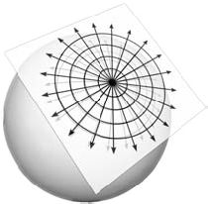
Parameterization
We parameterize the surface with Discrete Exponential Maps*
Advantages:
Very fast
Disadvantages:
Not optimal
Doesn’t work well for large regions
* R. Schmidt, C. Grimm, and B.Wyvill. Interactive decal compositing with discrete exponential maps. ACM Transactions on Graphics, 25(3):603–613, 2006.
Notes:
There are a lot of different ways to parameterize a surface. We chose discrete exponential maps because they are very fast, since they greedily build a parameterization.
Because our surfaces are smooth, and also because our sites are usually local (or can be if we split them up), we don’t need to worry much their disadvantages, which are that they don’t have any strong guarantees about conformality, so they don’t work particularly well for large regions.

Slide 36
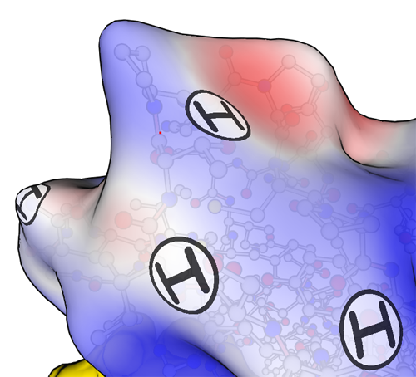
Decal type #1: Points of interest
'H' stickers represent potential hydrogen-bonding sites
Notes:
Some patches, such as hydrogen donating sites, have as their locations one single vertex. These can be represented as small, symbolic stickers.

Slide 37
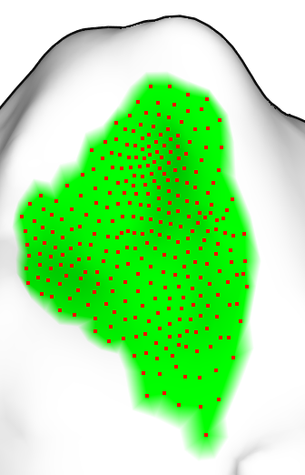
Decal type #2: Regions
Notes:
Others are formed from sets of vertices.

Slide 38
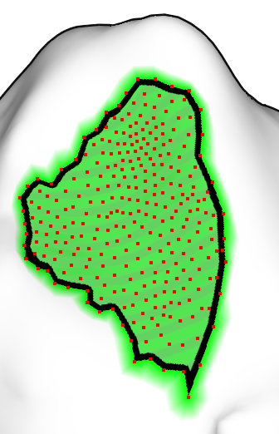
Decal type #2: Regions
Notes:
For these, we stroke the boundary...

Slide 39
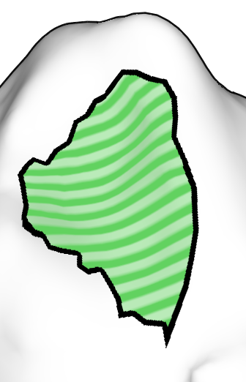
Decal type #2: Regions
Notes:
Here’s the same thing with the points removed.

Slide 40
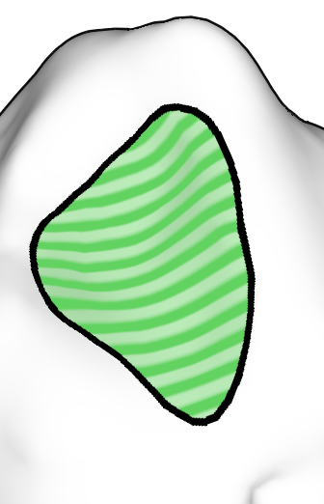
Decal type #2: Regions
Notes:
Then we apply a few iterations of loop smoothing in parameter space...

Slide 41
Surface patch smoothing
Before
After
Notes:
And finally texture the interior region. Here's the results before and after smoothing, side by side. One major advantage of this type of smoothing, besides looking better, is that we are no longer constrained by mesh construction, so we can subtly suggest the approximate nature of the underlying data.

Slide 42
Examples

Slide 43
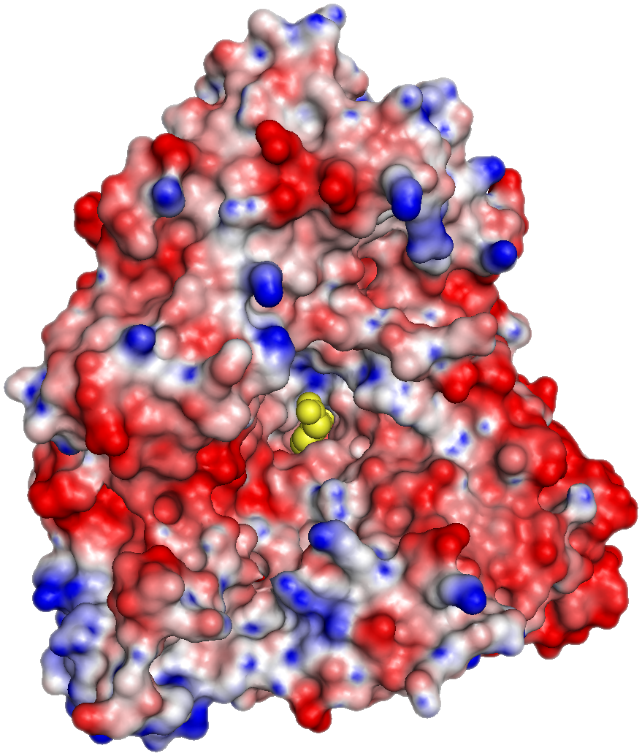
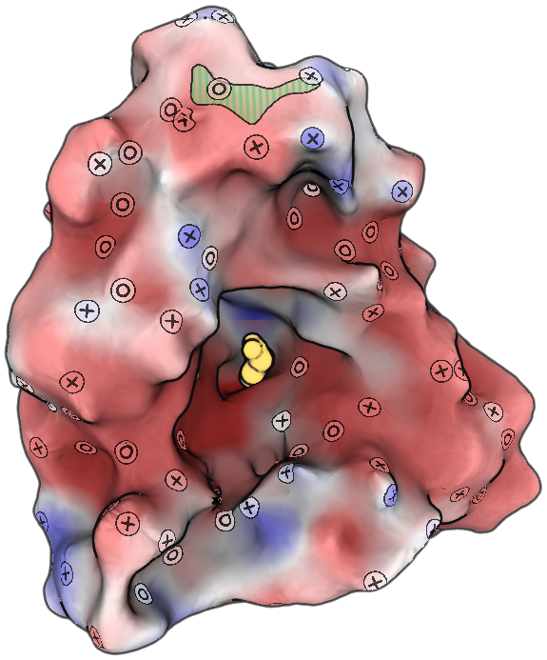
Examples
(1AI5)‏
Notes:
Penicillin Acylase laced with Nitrophyl-acetic acid

Slide 44
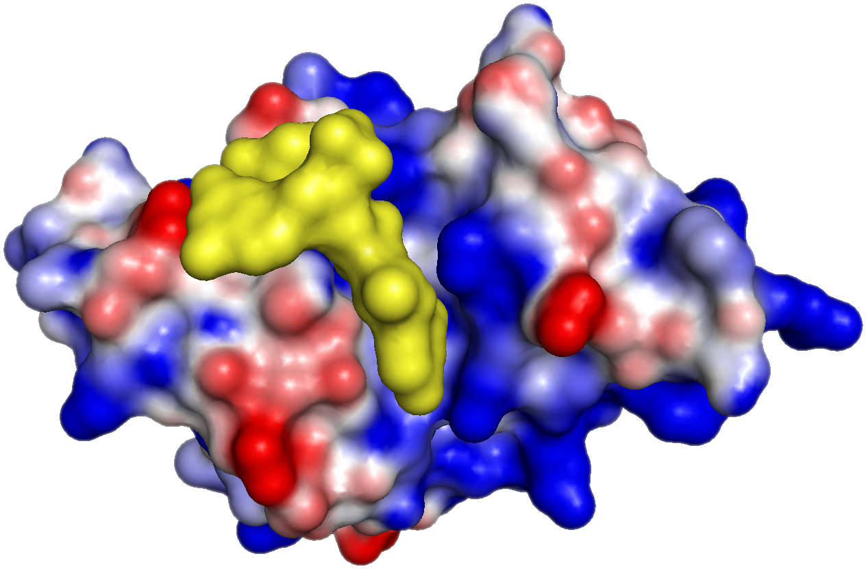
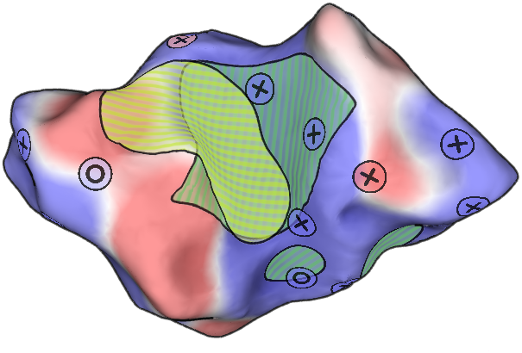
Examples
(Onconase)‏
Notes:
Highlight overlapping regions

Slide 45
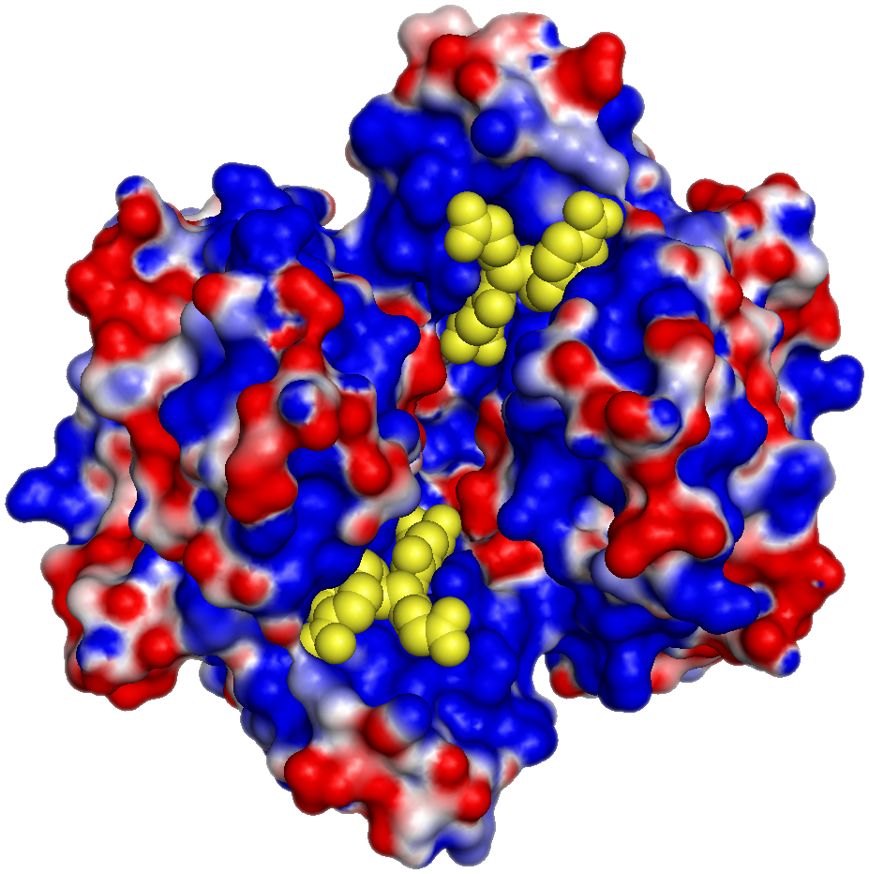
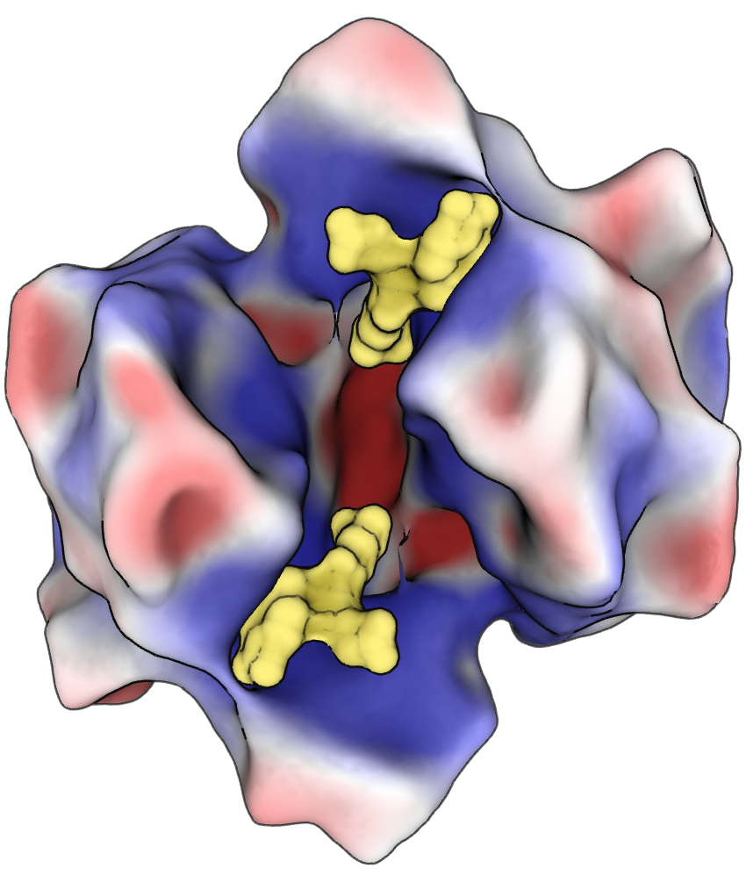
Examples
(1GLQ)‏
Notes:
Glutathione S-transferase complexed with glutathione
Inherent symmetry…

Slide 46
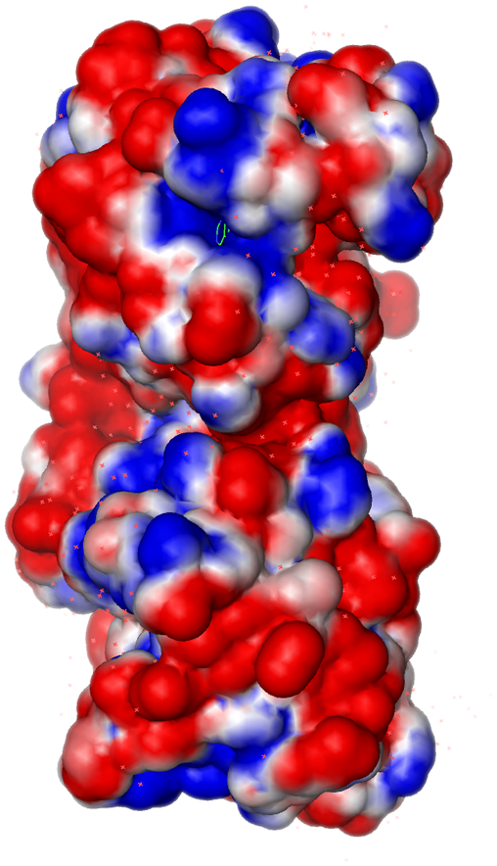
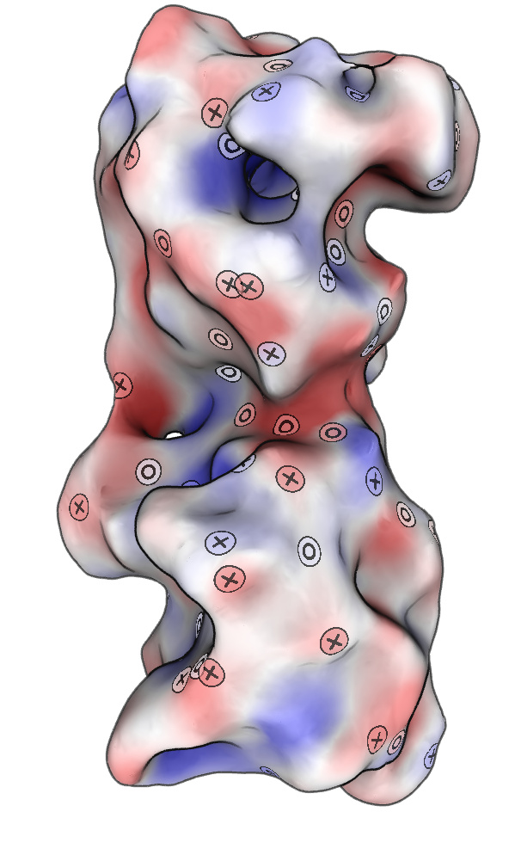
Examples
(1ANK)‏
Notes:
Adenylate kinase with bound AMP

Slide 47
Issues with our method
Where we fail:
Very large molecules need new abstractions
Parameterizing large regions
Possibly important fine detail lost
Lots of parameters
No real evaluative studies (yet)
Notes:
Now that I’ve shown you the benefits of our technique, I should mention where our current implementation fails, some of which are active areas of research…

Slide 48
Conclusion
Molecular surface abstraction:
Preserves large-scale structure
Complements existing visualizations
Allows for quick assessment of complex surfaces
Thanks to: Michael Gleicher, George Phillips, Aaron Bryden, Nick Reiter.
And to CIBM grant NLM-5T15LM007359

Slide 49
Thank you!
Questions?

